Slide 1

Cool Roof Rebate Program
Angela Futter, Project Manager
Louisville Office of Sustainability
July 26th, 2017

Slide 2
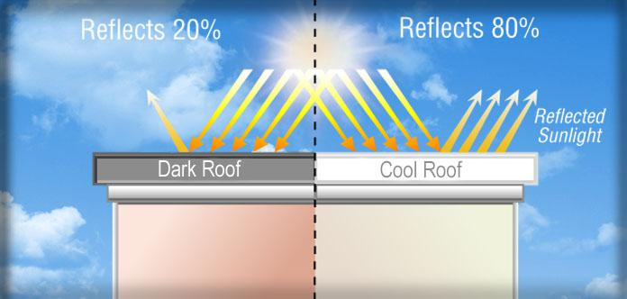
Cool Roofs
Roof material that acts to reflect solar rays rather than absorb
Typically lighter in color
Shingle, metal or coating
Benefits
Reduced energy consumption
Lower energy cost
Cooler house
Cooler community
Reduced air pollution
Reduced greenhouse gas
Improved human health and comfort

Slide 3
Overview of Program
$1 per sq ft cool roof installed, with goal of over 200,000 sq ft new cool roofs
High heat districts (1, 3, 4, 5, 6, 12, and 14) will receive 60% of funding
$1 per sq ft with residential max of $2,000 and commercial $5,000-low and $10,000-steep)
Condos with 10 or less units max at $2,000 and more than 10 units at $5,000
Cool roofs have a higher upfront cost the rebate helps to cover that additional cost. Property owner then recoup energy costs and the community benefits.
IT’S A WIN-WIN FOR EVERYONE!

Slide 4
Program Requirements
Product must be ES certified
Installed by contractor in good standing
Over air conditioned space
Property owner must be applicant
Located in Jefferson County
If business, in compliance with MRC and HRC
No liens and current on taxes

Slide 5
Requirements for Reimbursement
Issued after installation and submission of:
  Complete application
  Purchase receipt
  Photos of completed project
  Documentation of roof size, brand and color of material used
  W-9
  Document stating no liens or outstanding taxes

Slide 6
For more information:
Program details and online application
https://louisvilleky.gov/government/sustainability/incentives#1
Contact me directly
Angela.futter@louisvilleky.gov
502-574-1976

